Slide 1


Algorithmic image processing 2.0
Artemiy Firsov

Slide 2
Five minutes questionaire
Image processing math problem statement
What is a histogram?
3 types of histograms manipulation
Template color correction
Grayworld
What is a convolution?
Linear, gauss, median filters
What is a gradient and how is it used?

Slide 3
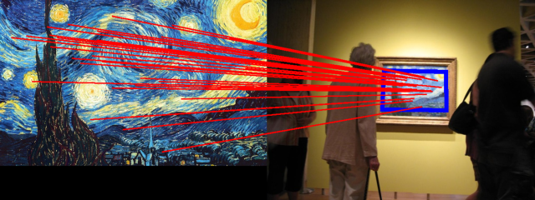
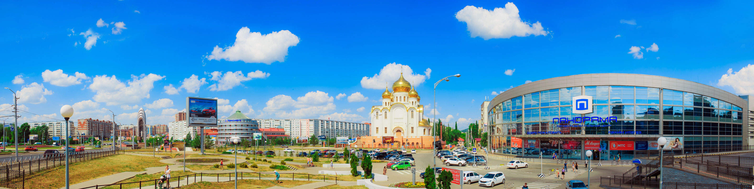
Images matching
Getting features of object image
Locate THE SAME object on a different photo

Slide 4
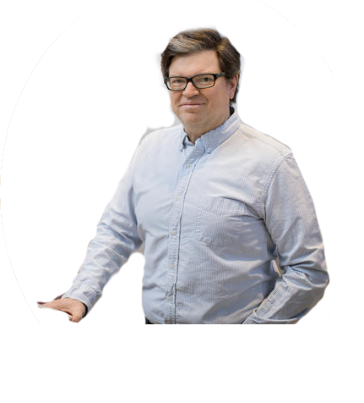
find yann game

Slide 5
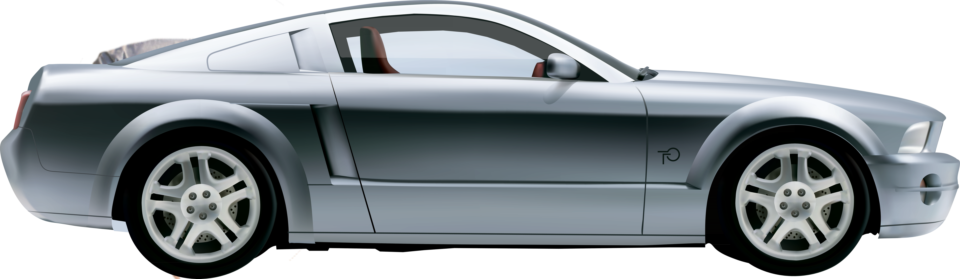

Slide 6
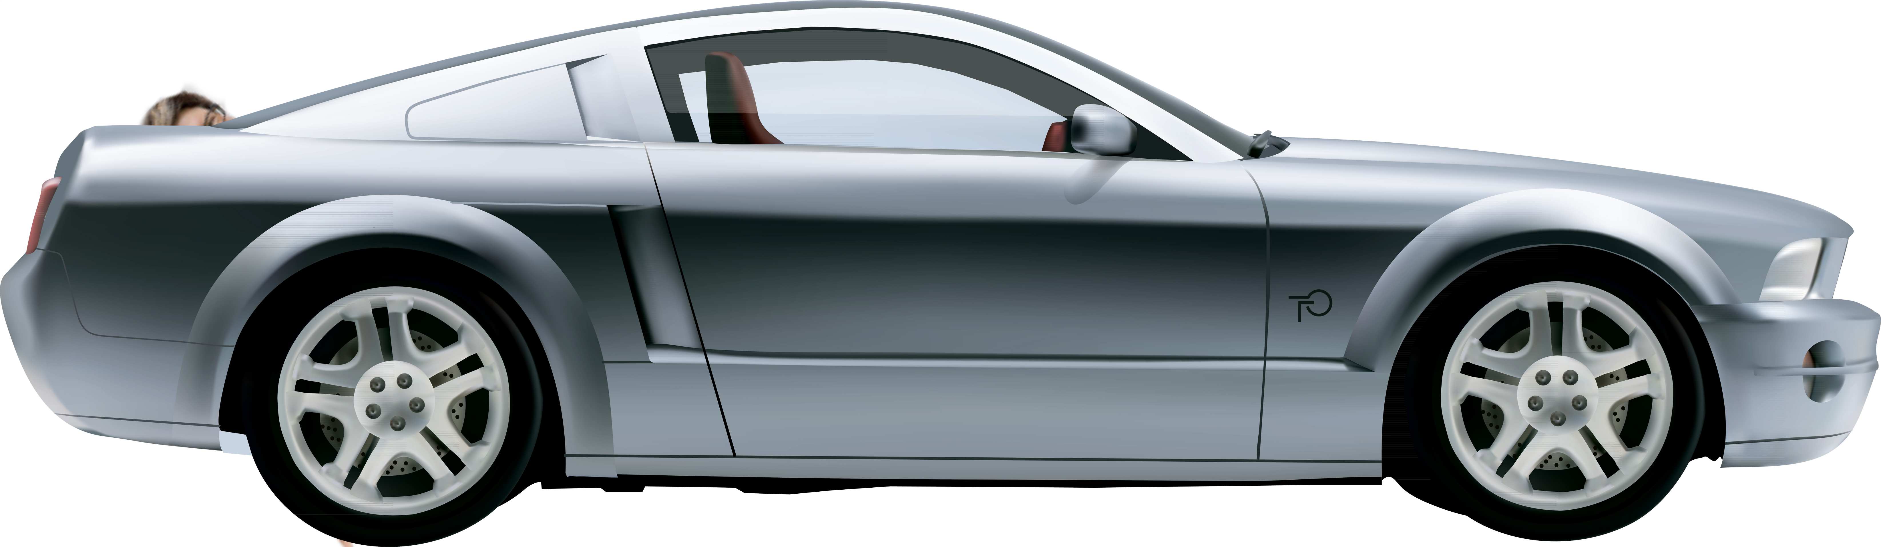

Slide 7
Local features
What can be considered a local feature?
Why are they important?
How to use them?

Slide 8
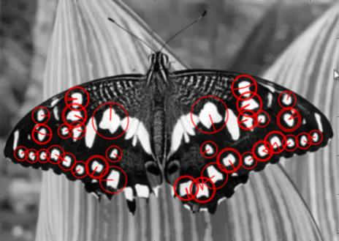
Local features
Features, keypoints(opencv), local features, …
What can be considered a local feature?
Distinctive feature
Well distinguishable parts
Abrupt edges
Why are they important?
Help to deal with
Perspective changes
Scale changes
Overlapping
Rotation

Slide 9
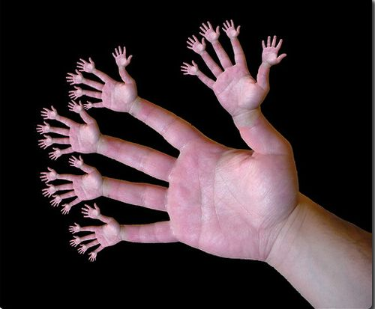
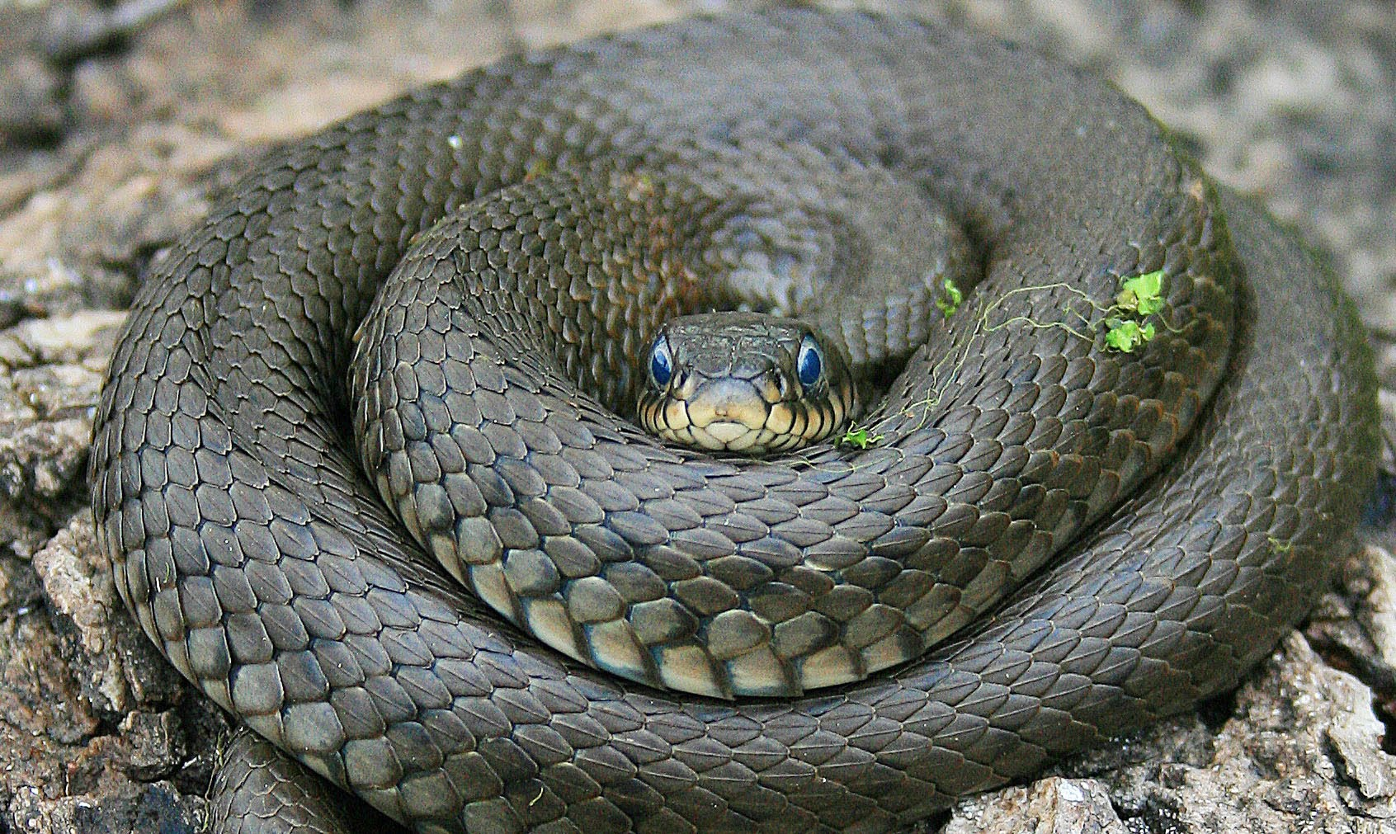
Characteristics

Slide 10
characteristics
Distinguishable in the local parts of an image

Slide 11
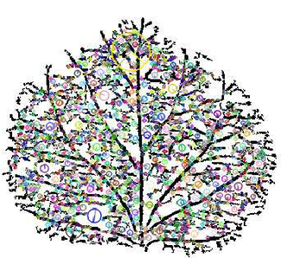
Characteristics
Their quantity is much less than the pixel number

Slide 12
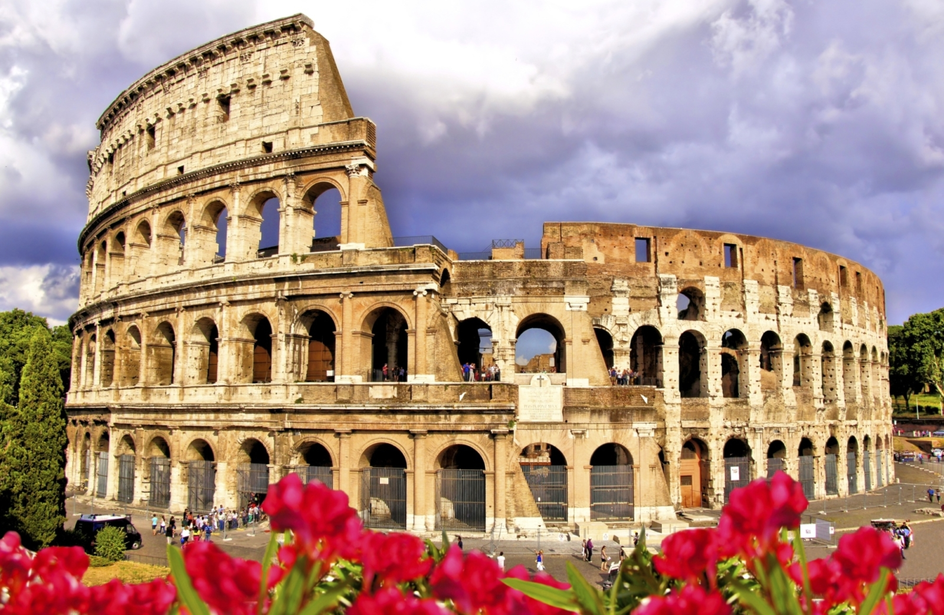
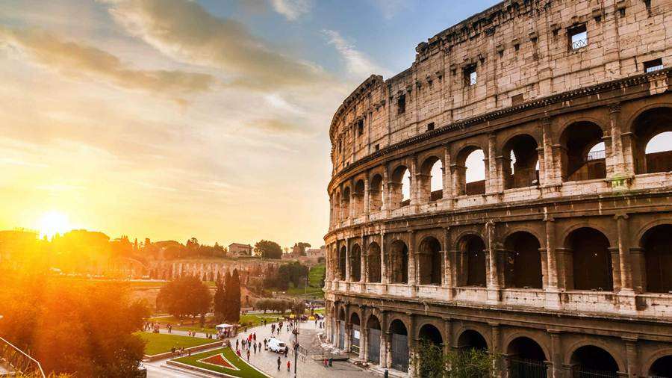
Characteristics

Slide 13
Characteristics
Unique in the scope of an object

Slide 14
Characteristics
Their quantity is much less than the pixel number – compactness
Distinguishable in the local parts of an image – locality
Unique in the scope of an object – significance
Stable to environment changes – invariance/ repeatability

Slide 15
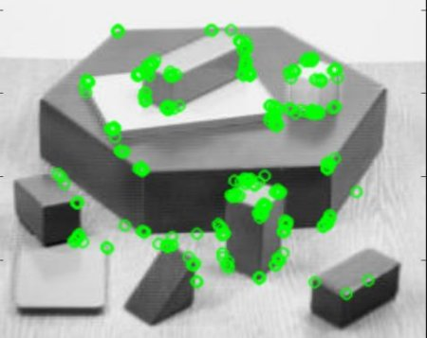
Basic local features
Corner
Spots

Slide 16
application
Photo alignment – panoramic photos, 3D maps, 2D->3D
DB search
Image classification
…

Slide 17
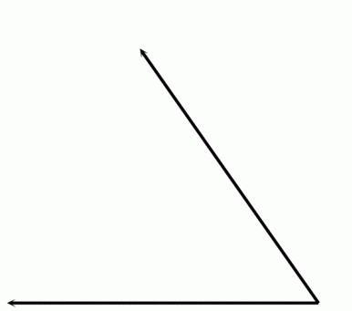
Corner feature
How to detect an angle?

Slide 18
Corner feature
Gradients!!!

Slide 19
Corner feature

Slide 20
Corner feature

Slide 21
Corner feature

Slide 22
Corner feature

Slide 23
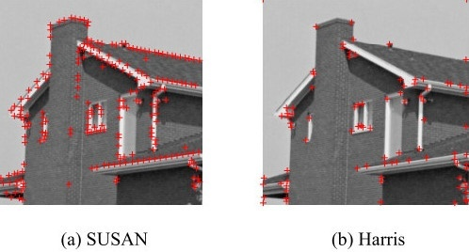
Harris detector

Slide 24
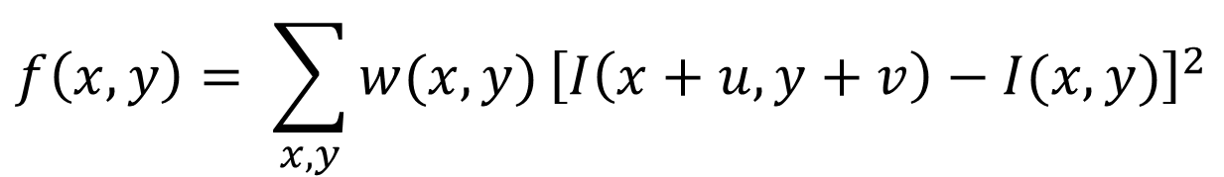
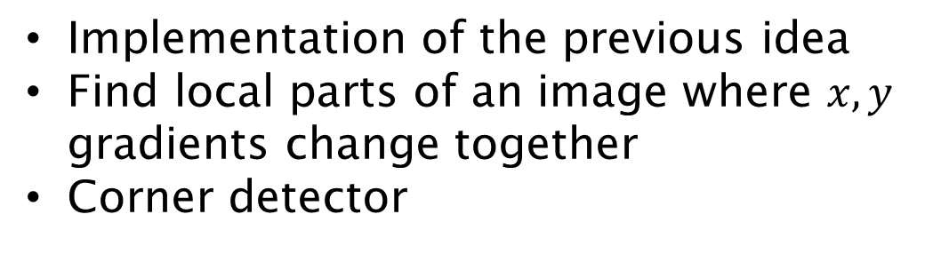
Harris detector
Implementation of the previous idea
Find local parts of an image where $x,y$ gradients change together
Corner detector
$$f\left(x,y\right)= \sum_{x,y}{w(x,y)}{\left[I\left(x+u, y+v\right)−I(x,y)\right]}^{2}$$
Deviation of the neighbor’s pixel values from the current point

Slide 25
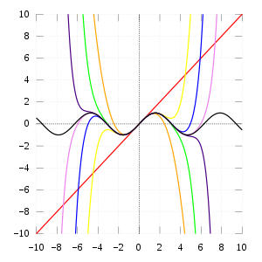
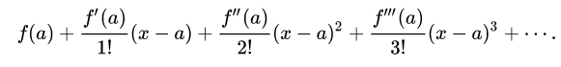
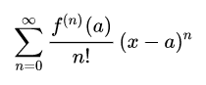
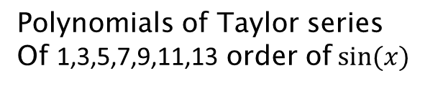
Taylor series
Polynomials of Taylor series
Of 1,3,5,7,9,11,13 order of $sin⁡(x)$

Slide 26
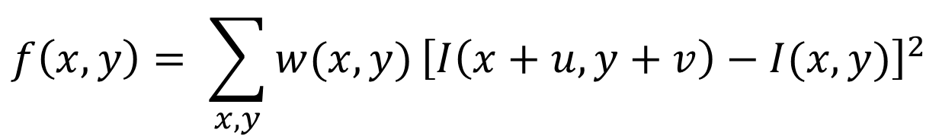
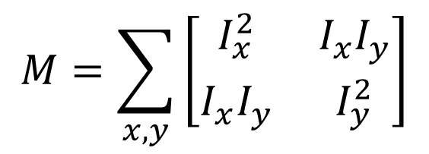
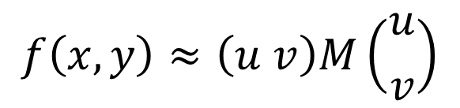
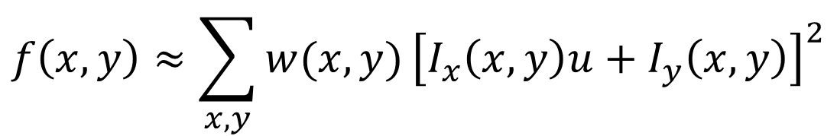
Harris detector
$$f\left(x,y\right)= \sum_{x,y}{w(x,y)}{\left[I\left(x+u, y+v\right)−I(x,y)\right]}^{2}$$
$$I\left(x+u, y+v\right)≈I\left(x,y\right)+I_{x}\left(x,y\right)u+I_{y}\left(x,y\right)v$$
$$f\left(x,y\right)≈\sum_{x,y}{w(x,y)}{\left[I_{x}\left(x,y\right)u+I_{y}\left(x,y\right)\right]}^{2}$$
$$M=\sum_{x,y}{\left[\begin{matrix}I_{x}^{2} & I_{x}I_{y} \\ I_{x}I_{y} & I_{y}^{2}\end{matrix}\right]}$$
$$f\left(x,y\right)≈\left(u v\right)M\left({u \atop v}\right)$$

Slide 27
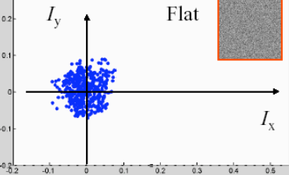
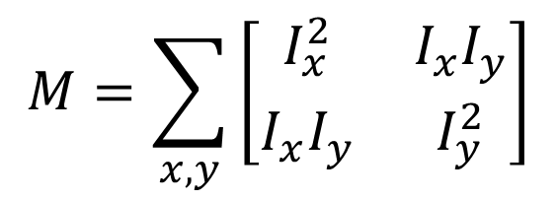

Derivatives matrix
$$M=\sum_{x,y}{\left[\begin{matrix}I_{x}^{2} & I_{x}I_{y} \\ I_{x}I_{y} & I_{y}^{2}\end{matrix}\right]}$$
Low changes of $I_{x},I_{y}$ - no features

Slide 28
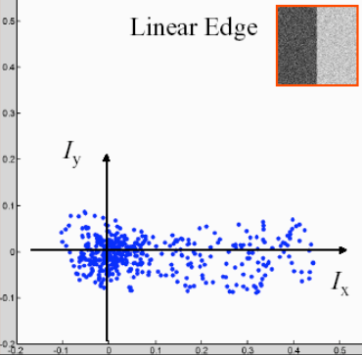
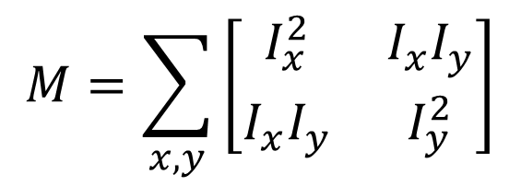
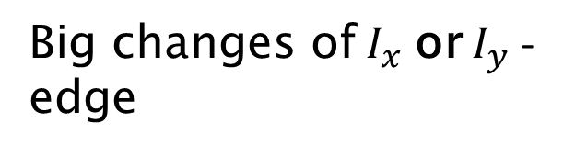
Derivatives matrix
$$M=\sum_{x,y}{\left[\begin{matrix}I_{x}^{2} & I_{x}I_{y} \\ I_{x}I_{y} & I_{y}^{2}\end{matrix}\right]}$$
Big changes of $I_{x}$ or $I_{y}$ - edge

Slide 29
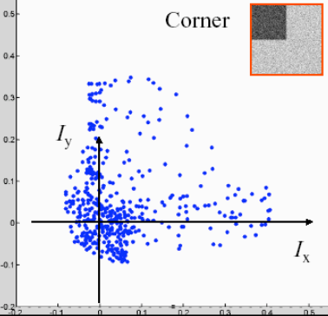
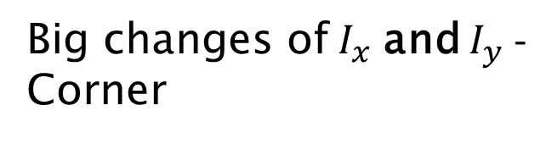
Derivatives matrix
$$M=\sum_{x,y}{\left[\begin{matrix}I_{x}^{2} & I_{x}I_{y} \\ I_{x}I_{y} & I_{y}^{2}\end{matrix}\right]}$$
Big changes of $I_{x}$ and $I_{y}$ - Corner

Slide 30
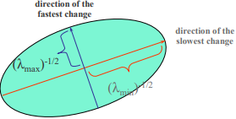
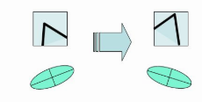
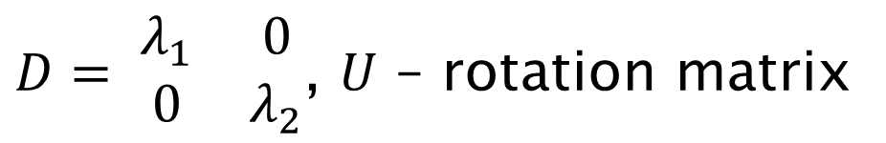
Derivatives matrix
$M=UDU^{−1}$ - possible of eigenvectors of the matrix form basis
$D= \begin{matrix}λ_{1} & 0 \\ 0 & λ_{2}\end{matrix}$, $U$ – rotation matrix
Invariant to rotation

Slide 31
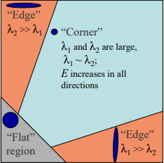
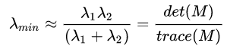
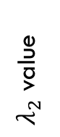
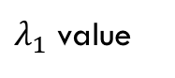
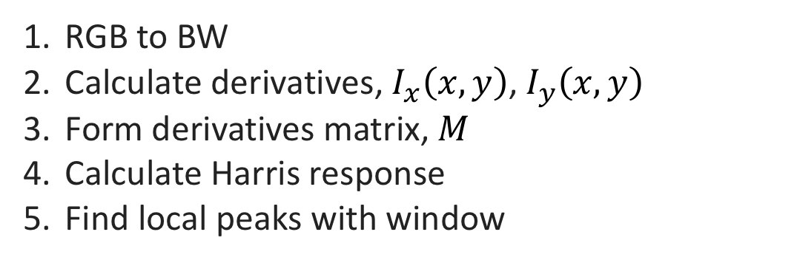
HArris detector
RGB to BW
Calculate derivatives, $I_{x}\left(x,y\right)$, $I_{y}\left(x,y\right)$
Form derivatives matrix, $M$
Calculate Harris response
Find local peaks with window
$λ_{2}$ value
$λ_{1}$ value
Simple explanation

Slide 32
Harris detector props
Invariant to rotation
Partially invariant to brightness change
Not invariant to scale change

Slide 33
Harris detector props
Invariant to rotation
Partially invariant to brightness change
Not invariant to scale change

Slide 34
How to take the scale into account?

Slide 35
How to take the scale into account?
Dynamically change the window size of local maximum finding
Such a procedure was introduced in spots detection

Slide 36
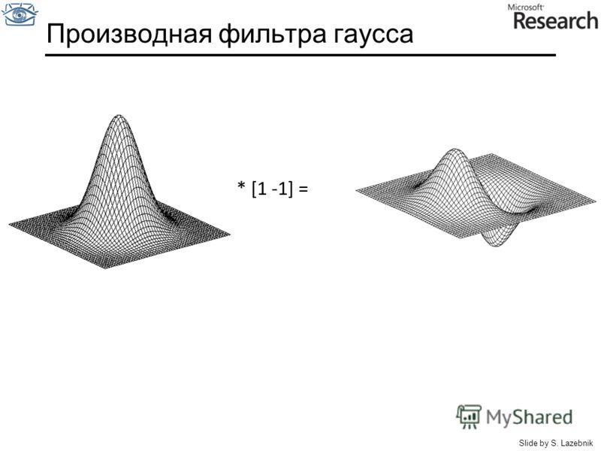
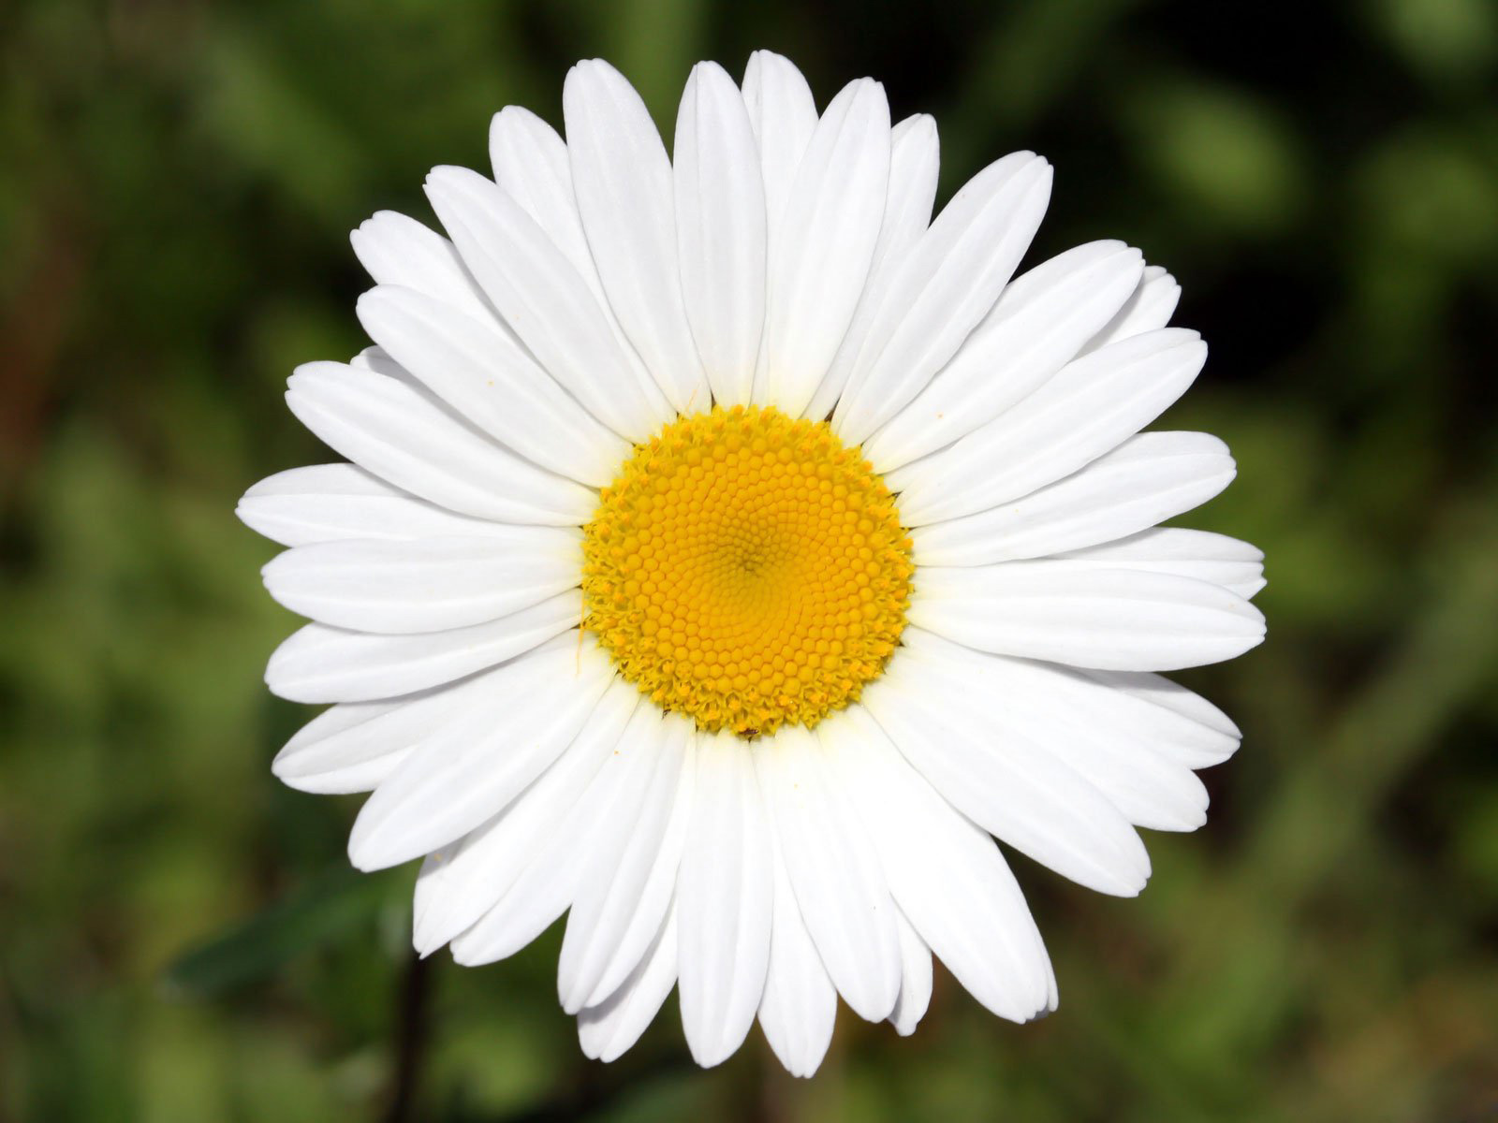
Gauss derivative

Slide 37
Gauss derivative

Slide 38
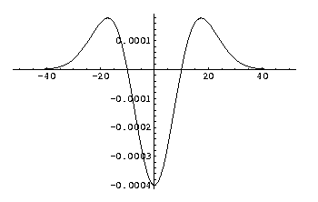
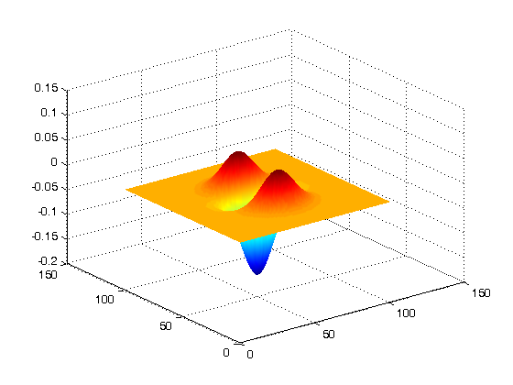
Second order Gauss derivative - laplacian

Slide 39
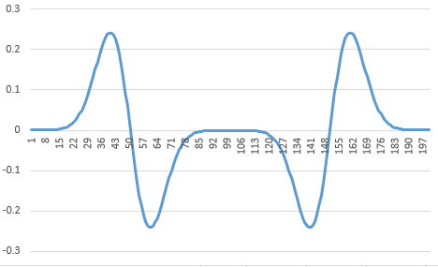
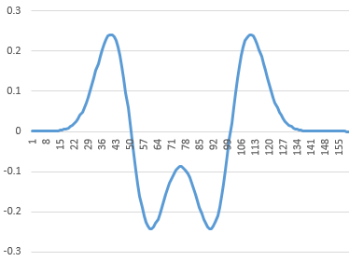
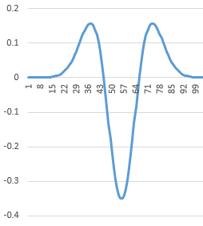
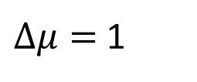
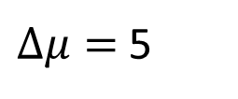
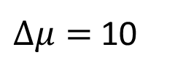
Laplacian is a spot detector
$Δμ=$10
$Δμ=$5
$Δμ=$1
Response gets bigger

Slide 40
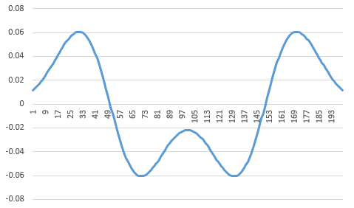




Attenuation problem
$$σ=1$$
$$σ=2$$
$$σ=16$$

Slide 41


Solution
The integral of the first order gauss derivative = $\frac{1}{σ\sqrt{2π}}$ . Multiply by $σ$. For Laplacian – by $σ^{2}$.

Slide 42

Algorithm
Apply Laplacian filter with fixed $σ$, calculate response with each pixel
Increase $σ$, repeat 1
Take the maximum value across all tries – we found the filter size
But there might be more than 1 local maximum

Slide 43


Slide 44


Slide 45


Slide 46


Slide 47


Slide 48


Example of Laplacian filter

Slide 49

Difference of gaussians
Convolution with many Laplacians with increasing filter size – not very efficient
But we can approximate Laplacian with the difference of 2 gaussians

Slide 50

Difference of gaussians

Slide 51

After all, you get all local features with the size of their neighborhood

Slide 52

But how to match local features?

Slide 53

descriptors
How to represent a local feature?
What should we take as a descriptor?

Slide 54
descriptors
Pixel brightness
Neighboring pixels
…

Slide 55
What neighborhood to take?
Size?
Shape?
What features to take?

Slide 56
And what neighborhood to choose?
Size?
Depends on the filter size when locating local feature
Shape?
In general – any
Square, circle, ellipse, …
Depends on the type of task
Features?
Gradient

Slide 57


HOG and SIFT
Locate local features
Calculate gradients histogram
Calculate for parts of the image
Find dominating direction
Shift invariance – using Gauss
For SIFT specifically
DoG – locate local features
16x16 cell divided by 4x4 bins

Slide 58

Example classifier
Take the labeled image dataset
Calculate gradient histograms
Using grid
Using local features
Take most frequent and label with the category
Take an input image, do same steps
Find similar gradients in DB, give an answer
SVM can be used

Slide 59
Thank you!

